Slide 1
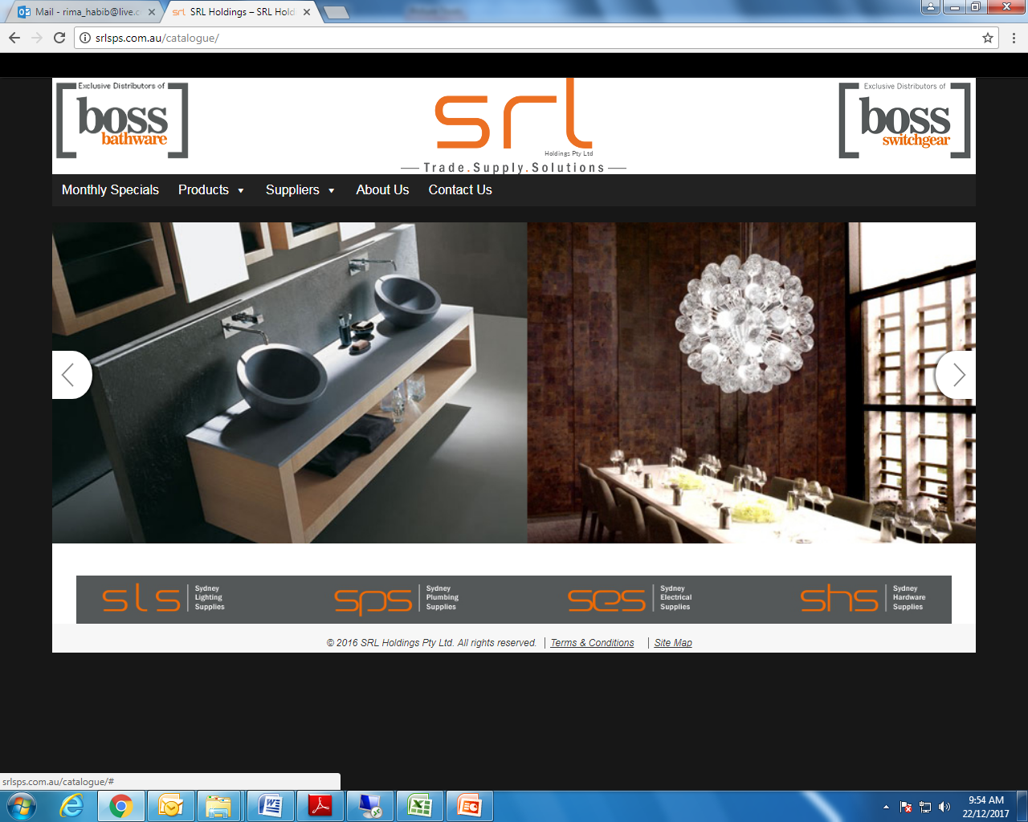

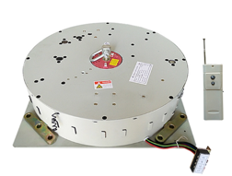
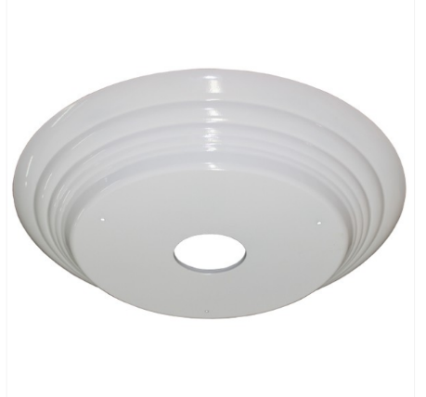
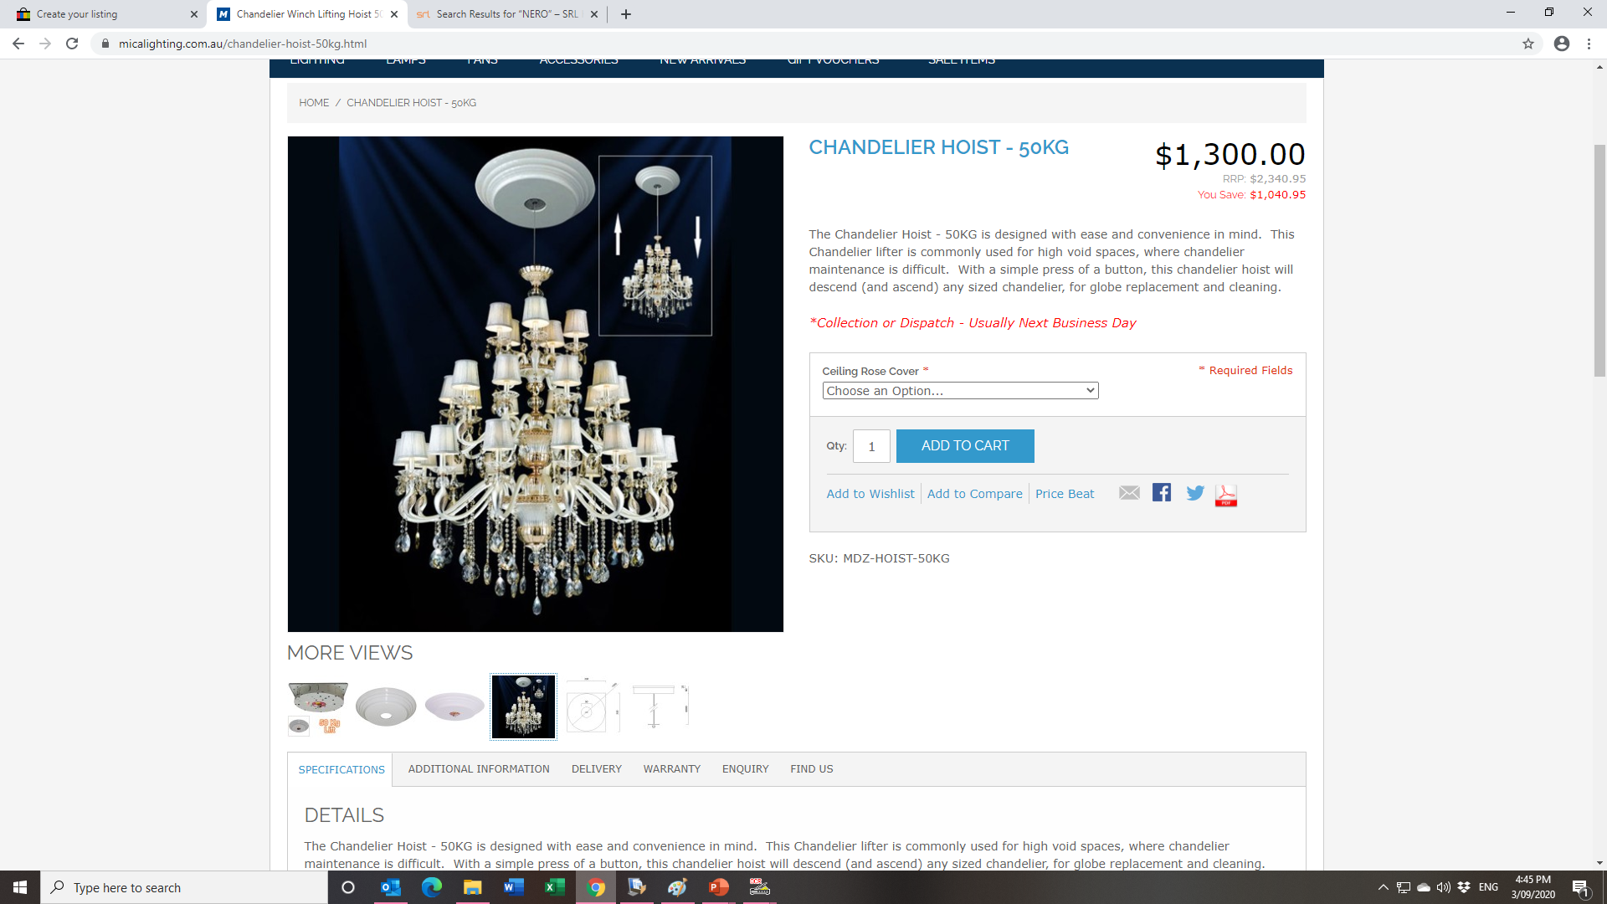

PRODUCT SPECIFICATION SHEET
LG-BOSS-DDJ250-6
CHANDELIER LIFT- 250KG
250KG 6M Remote Control Electric Winch Chandelier Lift Lamp Hoist Chandelier Motor 110V-240V
DETAILS
The Chandelier Hoist - 250KG is designed with ease and convenience in mind. This Chandelier lifter is commonly used for high void spaces, where chandelier maintenance is difficult. With a simple press of a button, this chandelier hoist will descend (and ascend) any sized chandelier, for globe replacement and cleaning.
The Chandelier Hoist - 250KG can be installed in 2 ways:
Inside your roof space - No Ceiling Rose Cover is required.
On the underside of your roof space - Ceiling Rose Cover is required
The Chandelier Hoist - 50KG has the following product features:
Ability to control the Chandelier Lighting - On & Off.
Hand-held Remote Control
Capacity:
  Weight Lifting Capacity - 5kg-250Kg.
  Max Drop – 6M
  Cut-out for Center Spindle - 92mm.
Dimensions: 330mm x 330mm x 60mm.
Mounting Direction - Horizontal Only.
Electrical Specifications:
  Motor Watts - 120w.
  Rated Current - 18A.
  Rated Power (Max Load) - 4KW.
  Diameter - 500mm.
  Height - 65mm.

Slide 2
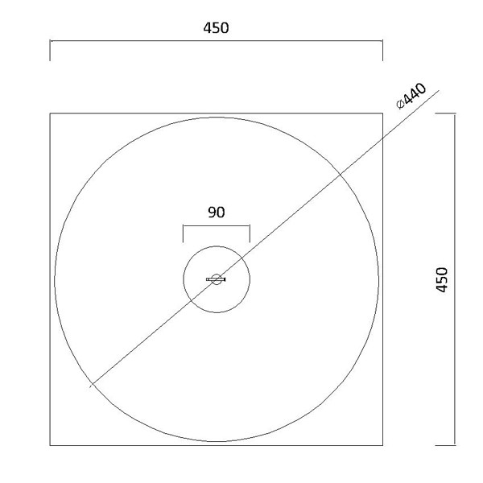
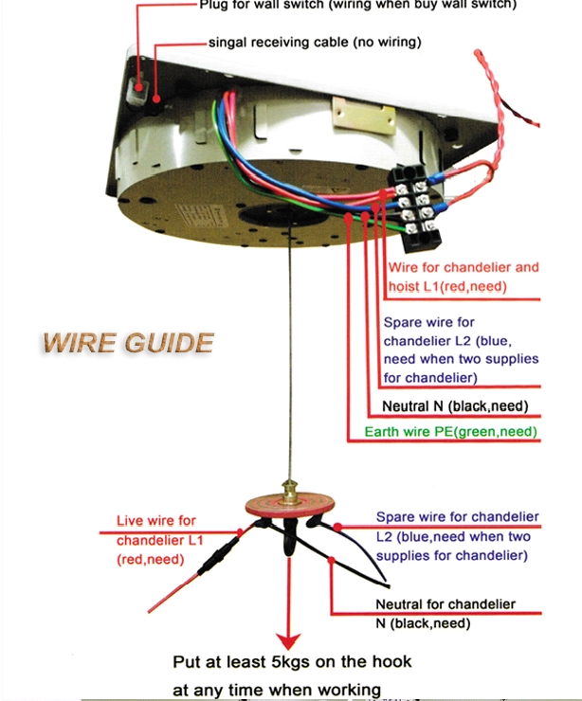
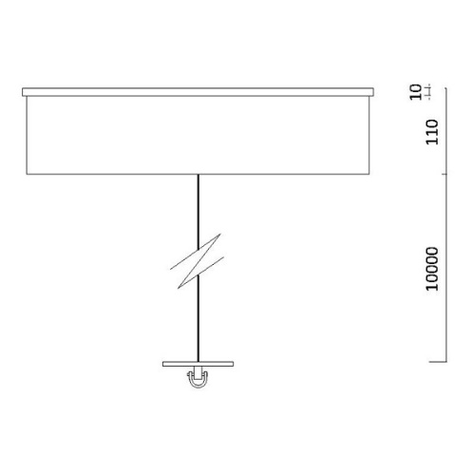
PRODUCT SPECIFICATION SHEET
Some useful information, regarding the operation of the hoist:
  When it is going in the downwards direction:
    It disconnects the lighting function.
    It comes down via a stainless cable.
Input - 240v AC
ASA: Australian Standards Approved
The lifter must have more than 5KG weight on the steel cable at any time,Otherwise,the lifter will not work,and malfunction may
happen.
Electrial connection should be done by a licensed Electrician.Keep a distance of at least 2 meters from the lifter and attachm
ent when The lifter is operating.
Don't clean the steel cable with water or any corrosive cleaner,cut off the power when maintain the lifter.
Examine the steel cable regularly for any damage or corrosive or excessive wearing.
Don't Overload the lifter,weight carried should be under the maximum carrying capacity.
The lifter should be installed by an experienced installer who has knowledge of structural carrying weights of the material/structure the lifter is tobe attached to.
The lifter is general lighting equipment which is not allowed to use at the inflammable environment.
Chandelier Or Pendant Winch Lift With Remote Or Wall Switch.

